Slide 1
What Clojure has taught me
Chris Zheng

Slide 2
Caveat
I am only mildly familiar with the Clojure libraries that I am using. Please look at official documentation afterwards.

Slide 3
About Me
Programming Experience
Intern at GoConnect (Java)
Intern at VPAC, ANSTO (C++, C#)
Conjugate Systems (All Above + Python)
Melbourne University (Matlab)
Currently (Clojure, PHP)

Slide 4
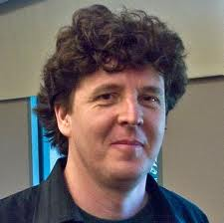
About Me
I Never Liked Programming ……
……. Until around 8 Months Ago

Slide 5
The Motivation
“If you were to compete and chose to write your software in C, they would be able to develop software twenty times faster than you. If you spent a year on a new feature, they'd be able to duplicate it in less than three weeks. Whereas if they spent just three months developing something new, it would be five years before you had it too.”
Paul Graham
http://www.paulgraham.com/icad.html

Slide 6
Killer Applications
Clojure – LISP, JVM + Concurrency
Clojurescript – Maintainable Browser Code
Datomic – Git + DB + Awesomeness
Light Table (Potentially) – The New Emacs

Slide 7
Making the easy stuff easy, and the hard stuff possible.
- Programming Clojure

Slide 8
Current Learning Curve
Proficiency
‘Got’
Macros
Looking at
Datomic
Ah Ha
Moment
(SICP)
Learning
Clojurescript
Watched Rich
Hickey’s Talk
Lots of Reading
And Videos
3
6
Months

Slide 9
Future Learning Curve
Log(Proficiency)
Current
Proficiency
1
10
Years

Slide 10
Clojure has made me a Better Programmer
Faster Project (and Idea) Deployment
Faster Rate of Learning
Better Creativity and Language Design
Profound Love of Programming

Slide 11
Talk Outline
Mindsets
Tools for Learning
Free Resources

Slide 12
Talk Outline
Mindsets
Tools for Learning
Free Resources

Slide 13


Organised
Creative
Logical
Artistic

Slide 14
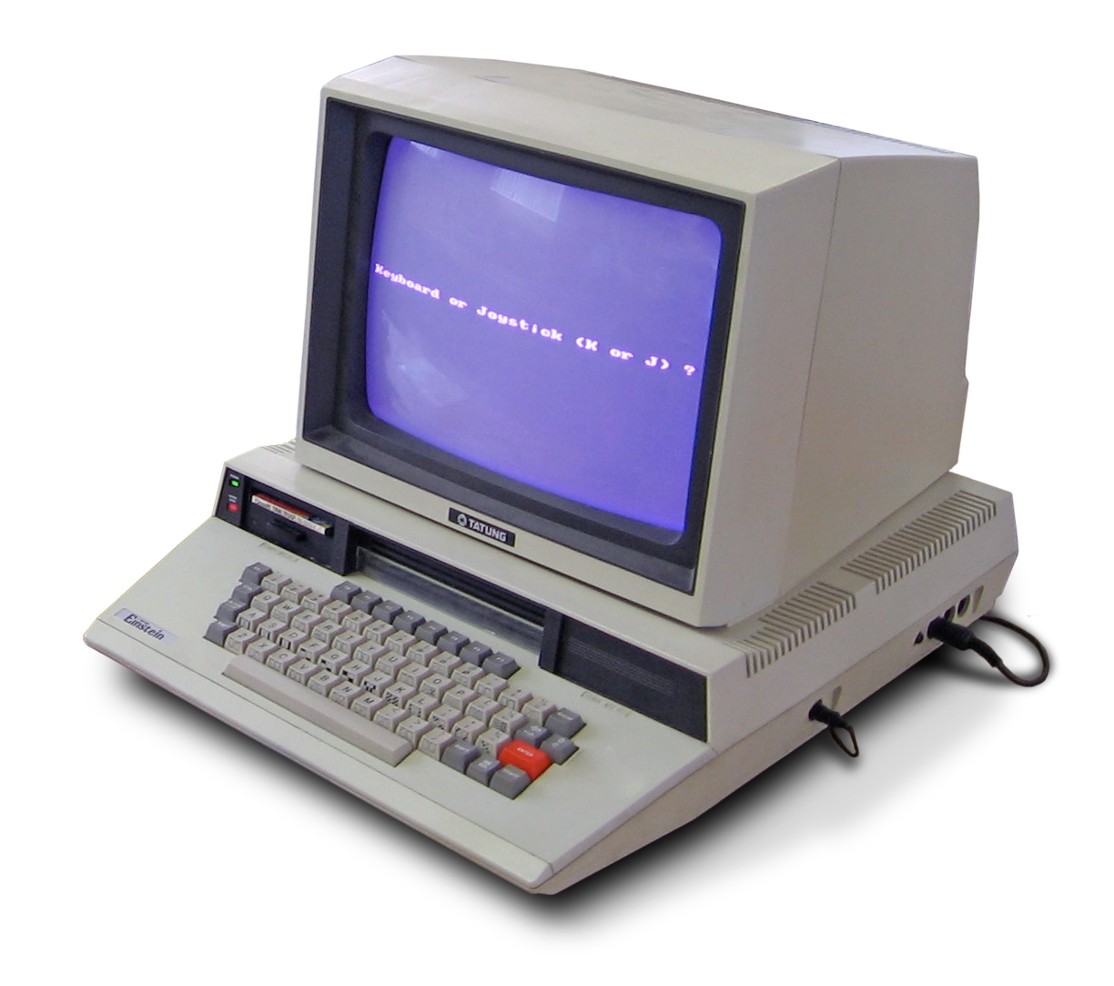
No Imagination
Organised
Logical
Procedural

Slide 15

Programming

Slide 16
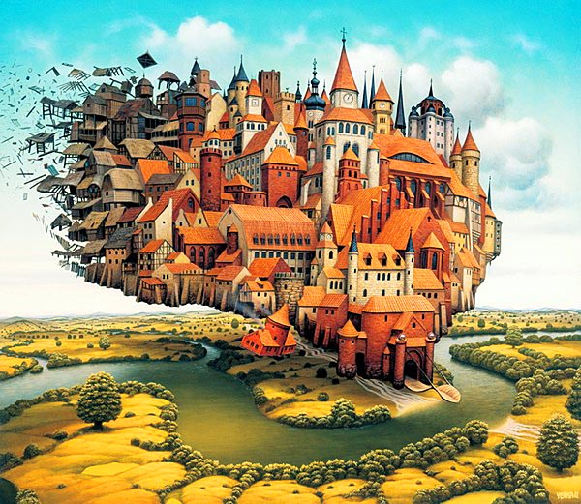
THE IDEAL

Slide 17




C++
Object Orientated Design
Data Encapsulation
STATE
THE REALITY
C#
Java
Python

Slide 18
What can we do?

Slide 19
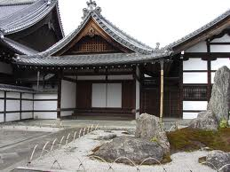
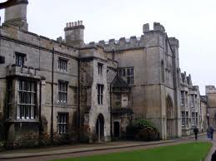

Language = Mindset
नमस्कार
Hello!
おはようご
ざいます

Slide 20
Changing our language = Changing our mindset!

Slide 21
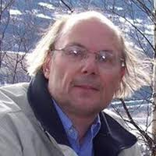
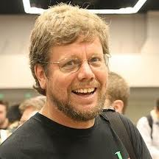
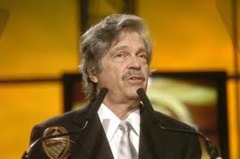
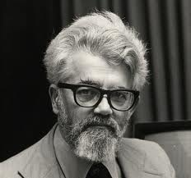
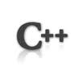


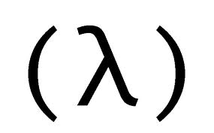
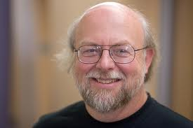
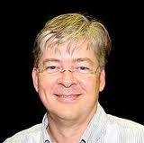
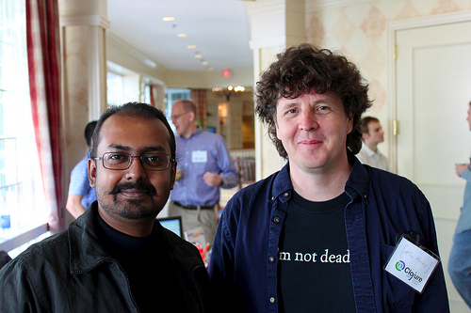


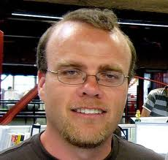
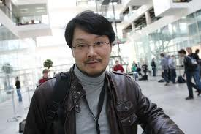



Frustrating
LANGUAGE CAPABILITIES
Awesome
Bjarne Stroustrup
Guido van Rossum
Alan Kay
John McCarthy
James Gosling
Anders Hejlsberg
Rich Hickey
Rasmus Lerdorf
Yukihiro Matsumoto
Awesome!
Meh!
HAIR HEIGHT

Slide 22
Clojure’s Mindset
Preventing Bad Practices
(Language Restrictions)
Implement Languages, not Features
(Syntax)
Focus on Application, not Data Transcription
(Common Data Format)

Slide 23
Preventing Bad Practices

Slide 24
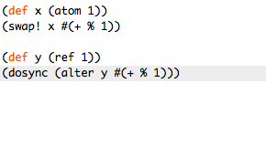
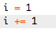
Do Not Overwrite!
27 characters
33 characters
7 characters

Slide 25
Implement Languages, not Features

Slide 26


Syntax
Object Orientated
Design
Everything is an Object
(Even if it is not)
vs
Use determines syntax
Domain Specific
Languages

Slide 27
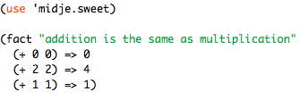
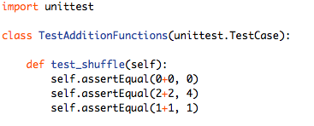
Unit Tests
82 characters
(with explanation)
151 characters

Slide 28
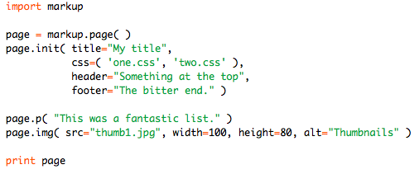
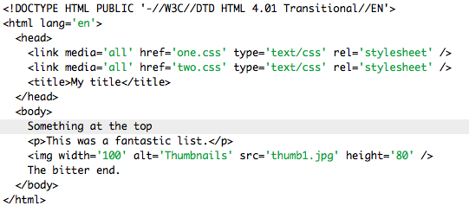
HTML - Python

Slide 29
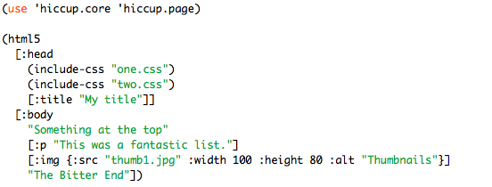
HTML - Clojure

Slide 30
HTML - Comparison

Slide 31
Many More
Using classes to model relationships becomes awkward very quickly
SQL
GUI
Math Equations

Slide 32
Focus on Application, not Data Transcription

Slide 33


Data
Encapsulation
Common Format
vs

Slide 34
Encapsulation
Same Data, Different Containers
PO.showX()
PAGE-OBJECT
Webpage
Application
DB
X
APP-OBJECT
DB-OBJECT
AO.getX()
DO.getX()

Slide 35
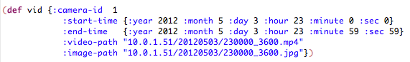
Common Format
Worry About Transforms, not Data
G(F(x))
Webpage
G()
Application
F()
DB
x
F(x)
x

Slide 36

Talk Outline
Mindsets
Tools for Learning
Free Resources

Slide 37
Talk Outline
Mindsets
Tools for Learning
Free Resources

Slide 38
Deploy First, Ask Questions Later

Slide 39
Terminal + Textmate
“IDE”
(Occasionally Eclipse)

Slide 40
Commands
autojump (j)
cd
git …
mate (e)
lein
cake (clojure repl tools)
cljr

Slide 41
The Big Picture

Slide 42
BIG
IDEA

Slide 43
INTERNET
BIG
IDEA
Experience
Friends

Slide 44
Small Idea
Small Idea
Small Idea
Small Idea
BIG
IDEA
Small Idea
Small Idea
Small Idea
Small Idea
Small Ideas

Slide 45
Environment
Small Idea
Small Idea
Small Idea
Small Idea
BIG
IDEA
Small Idea
Small Idea
Small Idea
Small Idea
Small Ideas

Slide 46
Code Dependencies
Library
Library
Library
Library
Code
Library
Library
Library
Library
Library

Slide 47
Code Dependencies
Library
Library
Library
Library
Code
Library
Library
Library
Library
Library

Slide 48
The most painful part of coding is in creation of the environment

Slide 49
Repl Tools
cake
cljr
lein
(with textmate + stickies)

Slide 50
My Workflow
Create/Get Code
Create Environment
Run/Explore

Slide 51
Explore Github Projects
Get Code
$ j buffer
$ git clone https://github.com/path/to/<code>.git
Create Environment
$ cd <code>
$ cake deps
(occasionally mvn install)
Run / Explore
$ cake (repl or run)

Slide 52
Exploratory Code A
Get Code
<copy from website>
Create Environment
Run / Explore
textmate with cake plugin
<paste code and evaluate>

Slide 53
Exploratory Code B
Get Code
<copy from website>
Create Environment
$ cljr install <dependencies>
(mainly skip)
$ cljr repl
Run / Explore
<paste code to repl>

Slide 54
Full Projects
Get Code
$ j work
$ lein new <?template> <project>
Create Environment
$ cd <project>
Run / Explore
$ e . (runs textmate with cake plugin)
(occasionally - $ lein run)

Slide 55
Projects take < 5 shell commands to fully deploy

Slide 56
How it Works

Slide 57
MAVEN REPOSITORIES
CLOJARS
REPOSITORIES
ONLINE
libs
maven
LOCAL REPOSITORY
~/.m2
lein clojars
git
code
maven
BITBUCKET
maven
shell
command
project.clj
GITHUB
cljr
lein/cake

Slide 58
DEMO TIME!

Slide 59
demos
cljr - Simple webserver/database stack
ring (webserver)
compojure (routing)
korma (db)
cake - exploring datomic
lein – clojurescript development

Slide 60
Talk Outline
Mindsets
Tools for Learning
Free Resources

Slide 61
Talk Outline
Mindsets
Tools for Learning
Free Resources

Slide 62
News
Planet Clojure
http://planet.clojure.in/
Clojure Gazette
http://www.clojuregazette.com/archive.html

Slide 63
Talks
Rich Hickey
Hammock Driven Development
Simplicity Made Easy
Clojure for Java Programmers
http://blip.tv/clojure
Chas Emerick
Starting Clojure (Repl, Eclipse)
http://cemerick.com/2012/05/02/starting-clojure/

Slide 64
Tutorials
Hal Abelson, Gerald Jay Sussman
Structure and Interpretation of Computer Programs
http://ocw.mit.edu/courses/electrical-engineering-and-computer-science/6-001-structure-and-interpretation-of-computer-programs-spring-2005/index.htm
Brian Marick, ‘Midje Talk’ and ‘Ruby after Clojure’
http://vimeo.com/19404746

Slide 65
Tutorials
Full Disclojure
http://vimeo.com/channels/fulldisclojure/

Slide 66
Blogs
Nurulla Nakkaya
http://nakkaya.com/
Lau Jensen
http://www.bestinclass.dk/
Chris Granger
http://www.chris-granger.com/

Slide 67
Talk Outline
Mindsets
Tools for Learning
Free Resources

Slide 68
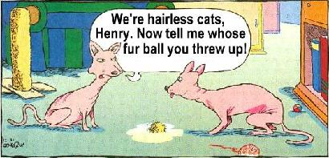
Thank You

Slide 72
leiningen
package manager similar to gems (ruby)
common: deps, run, repl
plugins:
marginalia (documentation)
midge (tests)
lots more

Slide 73
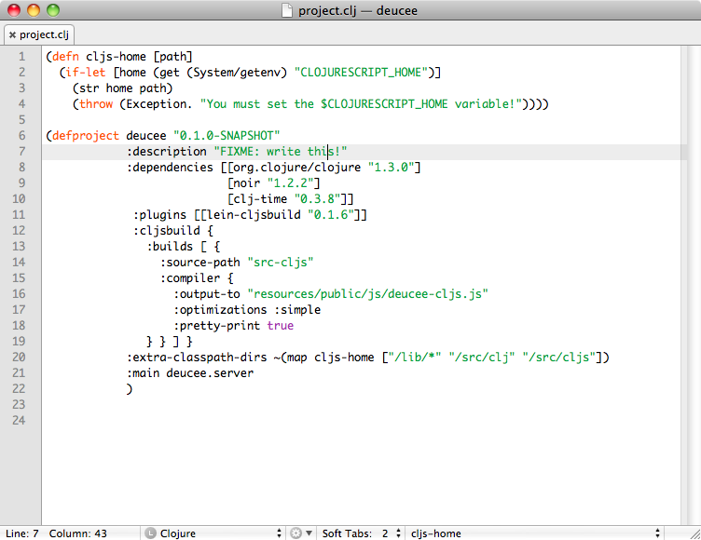
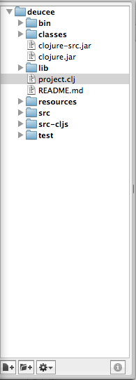
2
1
maven
3
$ lein deps
$ lein repl
$ lein run
~/.lein
1
2
clojars
3

Slide 74
leiningen - demo
demo: adder
git clone https://github.com/mmcgrana/adder.git
lein deps
1. lein run script/run.clj
cat script/run.clj
2. lein repl <= copy and paste script/run.clj
3. Make main.clj and put :main adder.main entry in project.clj

Slide 75
cljr
non-project based environment with lein
like python shell and irb
demo: (help, list, install, run, search, repl)
demo: (cut and copy from snippets)
Fibonnacci
Pascal’s
Gmail

Slide 76
eclipse + ccw
ide environment, easy for beginners
setup project with lein-cww
good for organising code
Commands
ctrl-option-L
ctrl-<RET>

Slide 77
eclipse - demo
lein new demo1
cd demo1
lein deps
lein ccw
Open Eclipse
Add Project
Load File in repl

Slide 78
Play
Learning and Creativity
Pleasurable and Enjoyable.
No Extrinsic Goals.
Spontaneous and Voluntary.
Active Engagement.
Element of Make-Believe.
No Resistence

Slide 79
Organisation
Cleaning and Optimization
Adds Consistency
Decrease Noise/Increase Understanding

Slide 80
“There might be tens of thousands of people who conceive the possibility of the same invention at the same time. But less than one in ten imagines how it might be done. Of those who see how to do it, only one in ten will actually think through the practical details and specific solutions. Of these only one in ten will actually get the design to work for very long. And finally, usually only one of all those many thousands with the idea will get the invention to stick in the culture”
- Danny Hillis

Slide 81
Motivation

Slide 82
C++
Object Orientated Design
Data Encapsulation
C#
Java
Python
THE REALITY

Slide 83
Namespaces > Classes
Much of the feature ‘encapsulation’ offered by objects can be achieved through namespaces
No more class instantiation.
No more ‘holder’ classes

